Slide 1

Global and Local Optimization
Professor Bo Liu
James Watt School of Engineering

Slide 2


Global optimal solution
Consider the following unconstrained opt. problem:
The search space: Ω
point, individual, solution: an element in Ω
x* in Ω is called a global maximal solution, if:
$$\max{ }f\left(x\right) \\ x∈Ω$$
$$f\left(x\right)≤f\left(x^{∗}\right) \\ ∀x∈Ω$$
An optimization problem may have several different global optimal solutions.

Slide 3

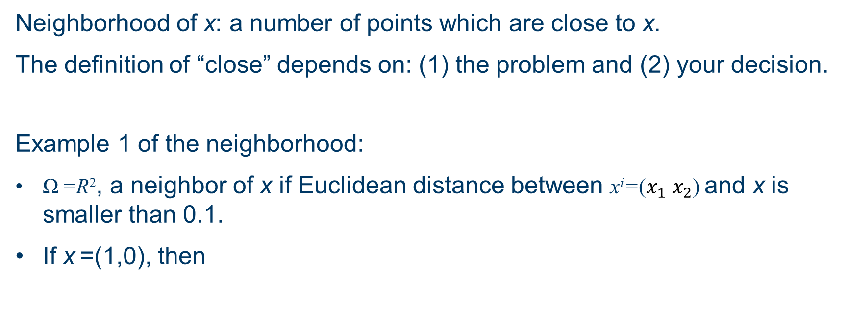
Neighborhood
Neighborhood of x: a number of points which are close to x.
The definition of “close” depends on: (1) the problem and (2) your decision.
Example 1 of the neighborhood:
Ω =R², a neighbor of x if Euclidean distance between x^{i}=($x_{1} x_{2}$) and x is smaller than 0.1.
If x =(1,0), then
x
0.1

Slide 4
Neighborhood
Neighborhood of x: a number of points which are close to x.
The definition of “close” depends on: (1) the problem and (2) your decision.
Example 2 of the neighborhood
x ={x₁, x₂, x₃, x₄}| x_{i}, ∈(0,1), i=1,2,3,4
Ω ={x^{i}} is a neighbor of x, if Hamming distance between x and x^{i} is 1.
When x= (1,0,0,1), the neighborhood of x is Ω ={(0,0,0,1),(1,1,0,1),(1,0,1,1),(1,0,0,0)}
A flip a neighbor

Slide 5
Neighborhood
Neighborhood of x: a number of points which are close to x.
The definition of “close” depends on: (1) the problem and (2) your decision.
Example 3 of the neighborhood:
  D is all the permutations from 1 to 4.
  Ω= {x^{i}} is a neighbor of x, if x^{i} can be obtained from x by a single swap (or m swaps). “Distance” is defined by “swap”.
  When x=(2, 3, 4, 1), the neighborhood of x=
  {(3,2,4,1), (4,3,2,1),(1,3,4,2), (2,4,3,1), (2,1,4,3), (2,3,1,4)}
  A swap a neighbor

Slide 6
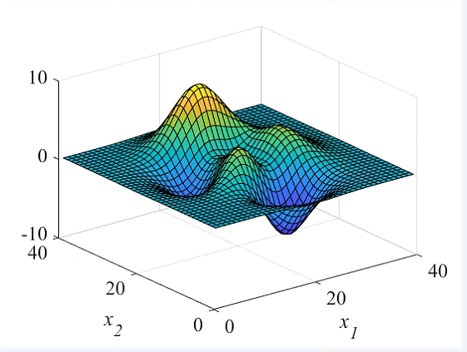
Local optimal solution
  Local optimal solution: a point that is not worse than any other points in its neighborhood.
  Depends on the neighborhood.
  A global optimal solution is always local optimal. Vice versa?
Global maximum
Local maximum

Slide 7
Local optimization
  Local optimization aims to find a local optimal point or find the optimal solution from a specific region of the search space.
  It often has a starting point to define where is the specific region.

Slide 8
Global optimization
  Global optimization attempts to find (a) global optimal point(s) of the search space.
    It may have a starting point or not. In many cases, only the search space is provided.
    It does not guarantee to find (a) global optimal point(s).

Slide 9
Unimodal and multimodal optimization problems
  Considering minimization
  Unimodal: (also called convex): the landscape has a single optimal value.
  Multimodal: the landscape has more than one local minimum.

Slide 10




Thanks!
#UofGWorldChangers
@UofGlasgow

